Slide 1
Criminal Analysis
Rute Souza de Abreu
Yuri Thomas Pinheiro Nunes

Slide 2
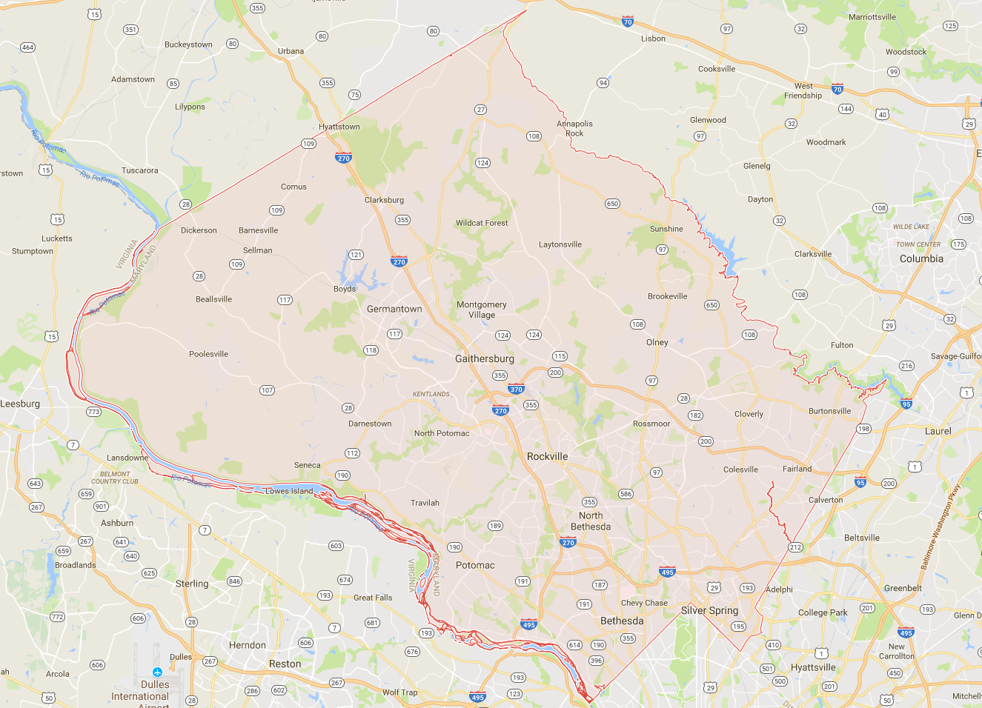
Montgomery County MD
Population: 1,043,863
Area: 1,310 km²
Seat: Rockville
Largest city: Rockville
Median age: 38.9

Slide 3
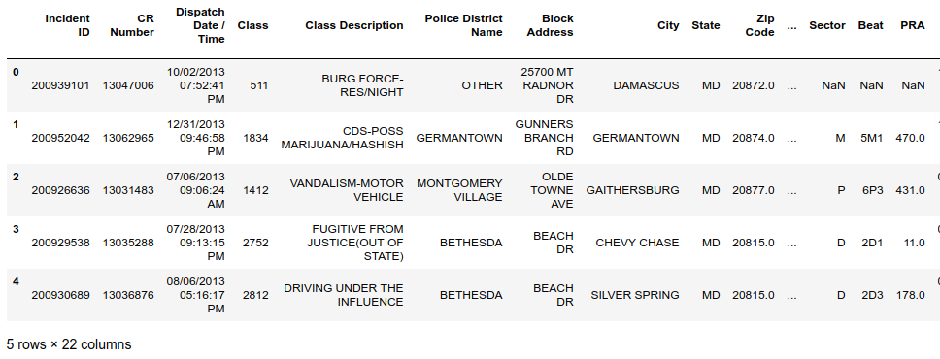
Dataset
23.369 entries
22 columns
Location
Time
Classification

Slide 4
Analysis method

Slide 5
Analysis method
Crimes Categorization
26 categories organized according to the response code reference of the county
Time Analysis
Hourly occurrence analysis
By hour
By day/night part
Weekly Analysis
By weekday
By week part (weekdays, weekend)
Interval between occurrences
Interval between the next occurrence of the same crime
Location Analysis
Crimes by City
Crimes by Police District

Slide 6
Insights

Slide 7
Time Analysis

Slide 8
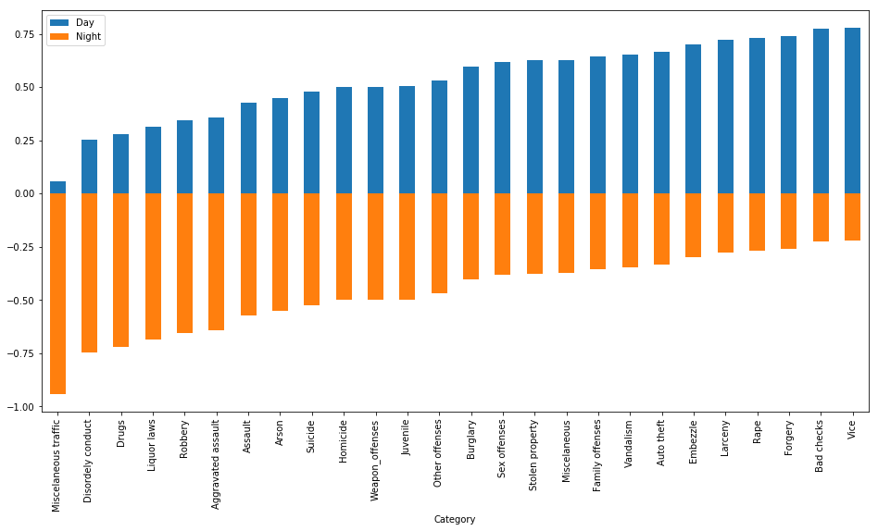
Hourly

Slide 9
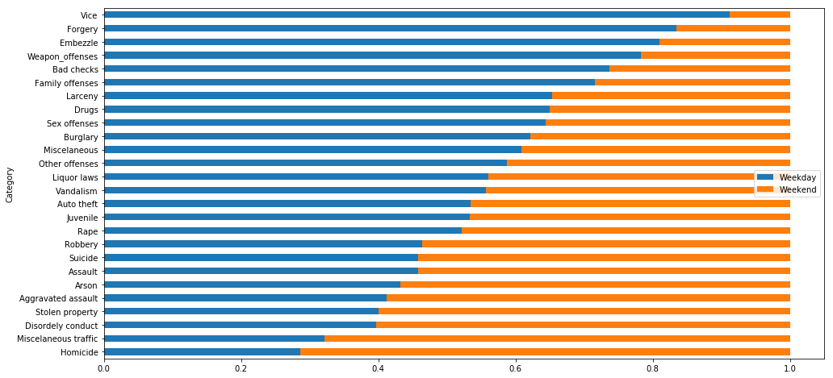
Weekly

Slide 10
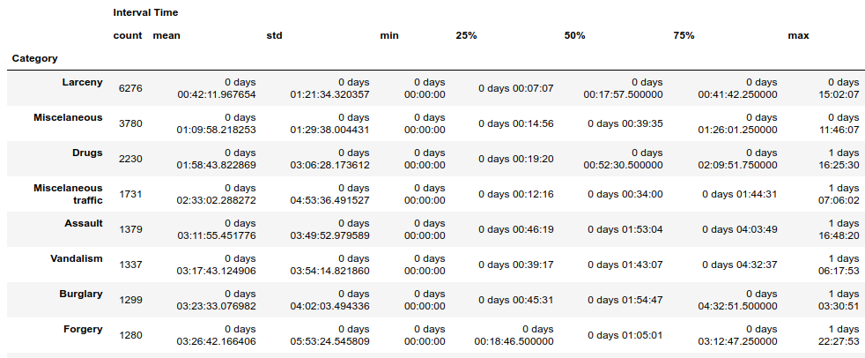
Interval

Slide 11
Location Analysis
Crimes by city and police district
Larceny is the most committed crime in 20 of the 32 cities, it is also the most committed in 6 of the 8 police districts.
The crimes in the miscellaneous category are also in the top two most committed crimes. Being the second highest percentage in 17 of the 32 cities and in 6 of 8 the police districts.

Slide 12
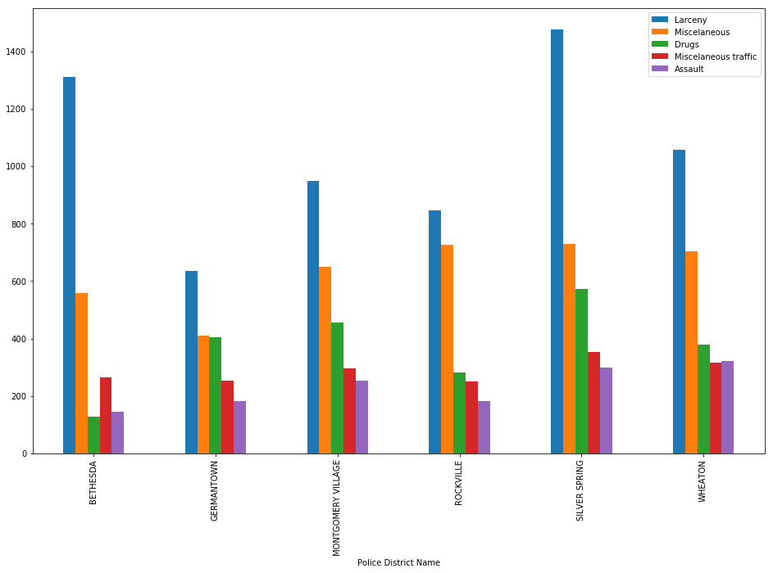
Police District

Slide 13
References
Code responses: http://wiki.radioreference.com/index.php/Montgomery_County_(MD)_Response_Codes
Rockville police report: http://www.rockvillemd.gov/DocumentCenter/View/10969
Police map: http://mcgov-gis.maps.arcgis.com/apps/Viewer/index.html?appid=4317830a05654b8f907e65515970a5ba
Dataset:https://data.policefoundation.org/Incidents/Montgomery-County-MD-MCPD-Incidents-07-2003-/c2mn-zwn5
Uniform crime reporting: https://www2.fbi.gov/ucr/handbook/ucrhandbook04.pdf
Stats Montgomery: https://datausa.io/profile/geo/montgomery-county-md/

